Slide 1
MALIGNANT COMMENTS CLASSIFIER PROJECT
SUBMITTED BY,
Madhurima Srivastava
Internship 30

Slide 2
INTRODUCTION
People use social media as a platform to express their opinions and views.
However, at the same time, this has resulted in the emergence of conflict and hate, making online environments uninviting for users.
Online hate, described as abusive language, aggression, cyberbullying, hatefulness and many others has been identified as a major threat on online social media platforms.
Our goal is to build a prototype of online hate and abuse comment classifier which can used to classify hate and offensive comments so that it can be controlled and restricted from spreading hatred and cyberbullying.

Slide 3
MULTI-LABEL VS MULTI CLASS CLASSIFICATION
In multi-class classification, the data can belong to only one label out of all the labels we have. For example, a given picture of an animal may be a cat, dog or elephant only and not a combination of these.
In multi-label classification, data can belong to more than one label simultaneously. For example, in our case a comment may be malignant, threat or loathe at the same time. It may also happen that the comment is positive/neutral and hence does not belong to any of the six labels.
The goal of the multi-label classification is to determine whether or not a comment is toxic or non-toxic. If toxic, to determine what kind of toxicity the comment is, like-in, malignant, highly-malignant, threat, rude, abuse or loathe. Thus, a model needs to be created in order to differentiate between comments and its categories.

Slide 4
DATA SOURCES AND THEIR FORMATS
The data set contains the training set, which has approximately 1,59,000 samples and the test set which contains nearly 1,53,000 samples. All the data samples contain 8 fields which includes ‘Id’, ‘Comments’, ‘Malignant’, ‘Highly malignant’, ‘Rude’, ‘Threat’, ‘Abuse’ and ‘Loathe’.
The label can be either 0 or 1, where 0 denotes a NO while 1 denotes a YES. There are various comments which have multiple labels. The first attribute is a unique ID associated with each comment.
The data set includes:
- Malignant: It is the Label column, which includes values 0 and 1, denoting if the comment is malignant or not.
- Highly Malignant: It denotes comments that are highly malignant and hurtful.
- Rude: It denotes comments that are very rude and offensive.
- Threat: It contains indication of the comments that are giving any threat to someone.
- Abuse: It is for comments that are abusive in nature.
- Loathe: It describes the comments which are hateful and loathing in nature.
- ID: It includes unique Ids associated with each comment text given.
- Comment text: This column contains the comments extracted from various social media platforms.

Slide 5
LIBRARIES USED

Slide 6
DATA PRE-PROCESSING
Checking the value counts of the features

Slide 7
Checking for null values

Slide 8
Checking statistical summary of the dataset
The minimum value and the maximum value of the attributes is same i.e., 0 and 1 respectively.
The mean and standard deviation is nearly 0-1 of all the attributes in the training dataset.
Here, with this statistical analysis, it is interpreted that there are no outliers as well as skewness present in this training dataset.
The count of each field is equal which shows that there are no missing values present.

Slide 9
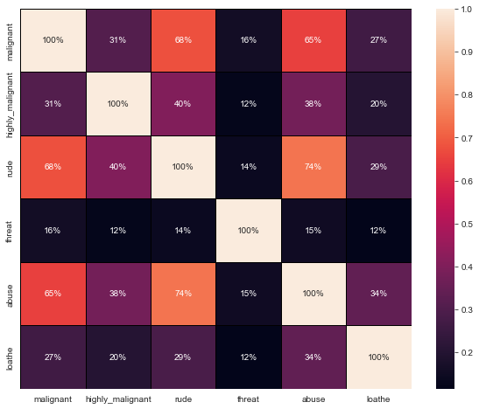
Finding relationship among data using correlation
The highest positive correlation is seen in between fields 'rude' and 'abuse'.
Attribute 'threat' is negatively correlated with each and every other feature of this training dataset . Overall the correlation among the attributes is not positive.

Slide 10
Dropping the Column
Due to the wide range of given data, it is extremely fruitful to clean, shape and set the data in the most suitable form. Dropping unnecessary columns declines the chances of producing errors. Thus, column ‘ID’ was dropped from the train dataset as every comment has its own unique id. After dropping the same, the dataset is now having 7 attributes in total including the target variables.
Cleaning the data using NLP
● Replaced the extra lines or ‘\n’ from the text.
● Transform the text into lower case.
● Replaced the email addresses with the text 'emailaddress'
● Replaced the URLs with the text 'webaddress'
● Removed the numbers
● Removed the HTML tags
● Removed the punctuations
● Removed all the non-ascii characters
● Removed the unwanted white spaces
● Removed the remaining tokens that are not alphabetic
● Removed the stop words

Slide 12
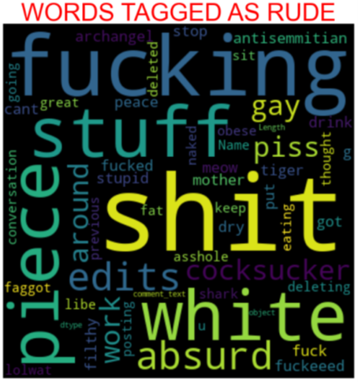
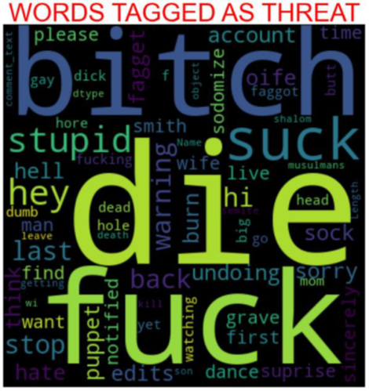
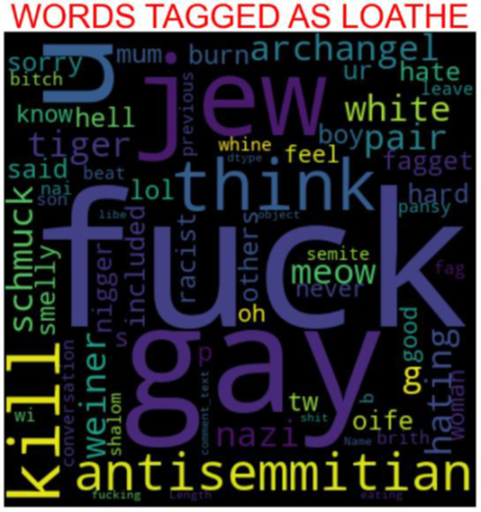
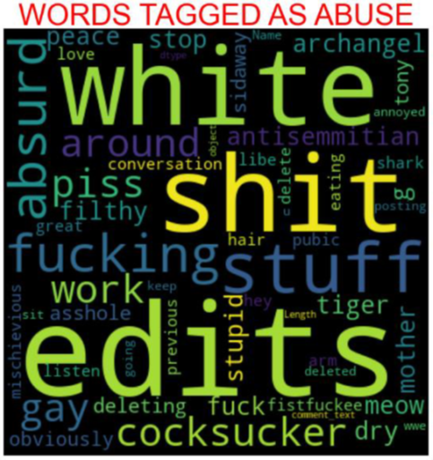
Plotting wordcloud for each feature

Slide 13
MODEL/S DEVELOPMENT AND EVALUATION
Separating independent and dependent features and converting the data into number features using Vectorizer

Slide 14
Splitting training and testing data, along with handling imbalanced dataset using RandomOverSampler

Slide 15
Building the model
The best 2 models performed well were RandomForest and XGBoost Algorithms and their outputs are shown as follows:

Slide 17
Final Result in a dataframe
After running the for loop of classification algorithms and the required metrics, we can see that the best 2 performing algorithms are RandomForestClassifier and XGBoostClassifier because the loss values are less and their scores are the best among all. Now, we will try Hyperparameter Tuning to find out the best parameters and using them to improve the scores and metrics values.

Slide 18
Hyperparameter Tuning
If we run GridSearchCV and RandomSearchCV, it takes more than 2 hours to run the code as the dataset is huge and the best params are not obtained from it due to more computational power requirement. The AUC Score, f1-score and recall value is high when we use randomforest with over sampling data. So, we choose RandomForestClassifier model with over sampled data as our best model among all models.
Confusion matrix:
[[41848 1156]
[ 1283 3585]]
Confusion matrix:
[[41848 1156]
[ 1283 3585]]

Slide 19
Plotting AUC_ROC Curve
Finalizing the model
We will final the model by predicting the values and saving the model in a pickle file, which will be used for prediction of test data

Slide 20
Predictions using test data
After predicting using test data, we will store the results in a csv file.

Slide 21
DATA VISUALIZATION
Plotting countplot for all features

Slide 22
Plotting pie chart plot

Slide 23
Distribution of comments length
Above is a plot showing the comment length frequency. As noticed, most of the comments are short with only a few comments longer than 1000 words. Majority of the comments are of length 500, where maximum length is 5000 and minimum length is 5. Median length being 250.

Slide 24
Plotting distribution plot for all features

Slide 25
CONCLUSION
After the completion of this project, we got an insight of how to preprocess the data, analysing the data and building a model.
First, we imported both training and testing data, which had nearly 150000+ records.
We did all the required pre-processing steps like checking null values, datatypes check, dropping unnecessary columns, etc.
We used the training data for doing Exploratory Data Analysis using various plots and recorded the observations.
While observing the results, we found that the dataset was in highly imbalanced side and we need to handle it, in order to avoid overfitting problem.
Using NLP, we pre-processed the comment text and did other steps.
As the problem was a multi-class classifier, we took a new feature known as label and combined the comment_labels output together using sum() and then stored in that feature. For a binary classification problem, we scaled the data accordingly.
After applying Tf-idf Vectoriser, we used an oversampling technique called RandomOverSampler for handling the imbalanced data. There, we took 75% of the high points data and sampled it to the low points data so that both weights could be balanced equally and we could get proper result.

Slide 26
Then, we split the data using train_test_split and then we started the model building process by running as many algorithms in a for loop, with difference metrics like cross_val_score, confusion matrix, auc_score, log loss, hamming loss, etc.
We found that RandomForestClassifier and XGBoostClassifier were performing well. The next step was to perform hyperparameter tuning technique to these models for finding out the best parameters and trying to improve our scores.
The major problem with this dataset occurred in this step. It took me nearly 2 hrs to run the code for finding out the best parameters itself as the dataset is large and more computational power was required. Even though we found the best algorithms, it took me 2 hrs to get the results.
Therefore, without hyperparameter tuning, we finalized RandomForest as the best performing algorithm by predicting the outputs, saving the model and storing the results in a csv file
Then, by using the model we got, another set of predictions were done by using the test data and the results were stored in a separate csv file.

Slide 27
Problems faced while working in this project:
More computational power was required as it took more than 2 hours
Imbalanced dataset and bad comment texts
Good parameters could not be obtained using hyperparameter tuning as time was consumed more
Areas of improvement:
Could be provided with a good dataset which does not take more time.
Less time complexity
Providing a proper balanced dataset with less errors.

Slide 28
Learning Outcomes of the Study in respect of Data Science
Through this project we were able to learn various Natural language processing techniques like lemmatization, stemming, removal of stopwords. We were also able to learn to convert strings into vectors through hash vectorizer. In this project we applied different evaluation metrics like log loss, hamming loss besides accuracy.
My point of view from my project is that we need to use proper words which are respectful and also avoid using abusive, vulgar and worst words in social media. It can cause many problems which could affect our lives. Try to be polite, calm and composed while handling stress and negativity and one of the best solutions is to avoid it and overcoming in a positive manner.

Slide 29
Thank you

